Slide 1


HEAVENS MOVIE
E X H I L A R A T I N G E N L I G H T E N I N G
E N C H A N T I N G

Slide 2

ABOUT THE TEAM
MENTOR:
Mr. Bhanu Kapoor
STUDENTS INVOLVED:
Deepanjali | (201500211)
Nandini Sharma | (201500429)
Sunishka Sharma | (201500717)
Tanmay Goyal | (201500738)
Vaibhav Jain | (201500764)

Slide 3

ABOUT PROJECT
The purpose of Heavens Movie is to automate the existing manual system with the help of computerized equipment and full-fledged computer software, fulfilling their requirements, so that their valuable data/information can be stored for a longer period with easy access and manipulation of the same. The required software and hardware are easily available and easy to work with.
The aim is to automate its existing system of retrieving data by making it more feasible through a single page. It will let user browse easily over the range of movies within a webpage and get filtered information.
The project describes how to manage for good performance and better services for the client.

Slide 4

Visual Studio Code
Visual Studio Code, also commonly referred to as VS Code, is a source-code editor made by Microsoft for Windows, Linux and macOS. Features include support for debugging, syntax highlighting, intelligent code completion, snippets, code refactoring, and embedded Git. Users can change the theme, keyboard shortcuts, preferences, and install extensions that add additional functionality.
In the Stack Overflow 2021 Developer Survey, Visual Studio Code was ranked the most popular developer environment tool, with 70% of 82,000 respondents reporting that they use it.
IDE USED
Visual Studio Code includes basic support for most common programming languages. This basic support includes syntax highlighting, bracket matching, code folding, and configurable snippets. Which makes it a code friendly IDE.

Slide 5

API USED
The API service is for those of you interested in using our movie, TV show or actor images and/or data in your application.
Our API is a system we provide for you and your team to programmatically fetch and use our data and/or images.
To register for an API key, click the API link from within your account settings page .

Slide 6

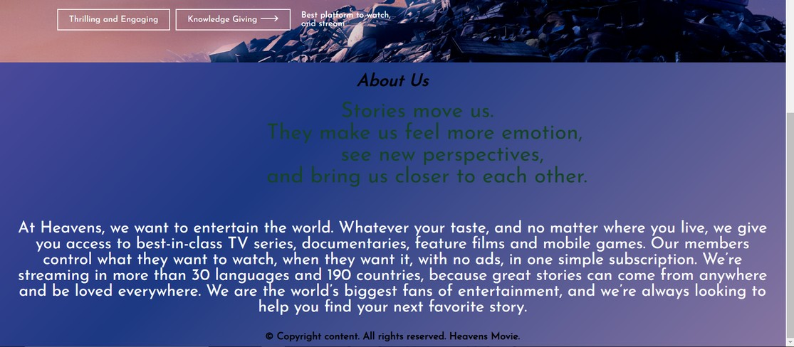
Landing Page
Landing Page is the first page that we see when we run our application. It is also known as Launch Screen.
It commonly consists of the website logo and login option while the website is loading its features/components.

Slide 7
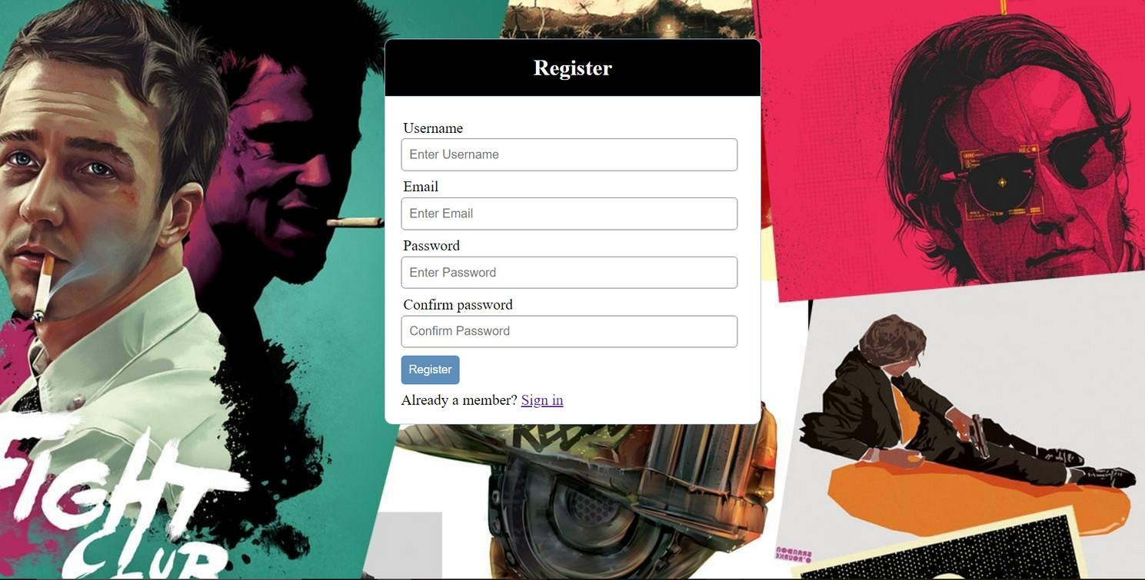
Sign Up Page
The registration page has features like username,email,password , confirm password and register button.
The user can create and an account by giving their full name, email, password and then confirm password.
Once the Register button is clicked, the user credentials will get stored. If the user has already an account then can simply sign in.

Slide 8
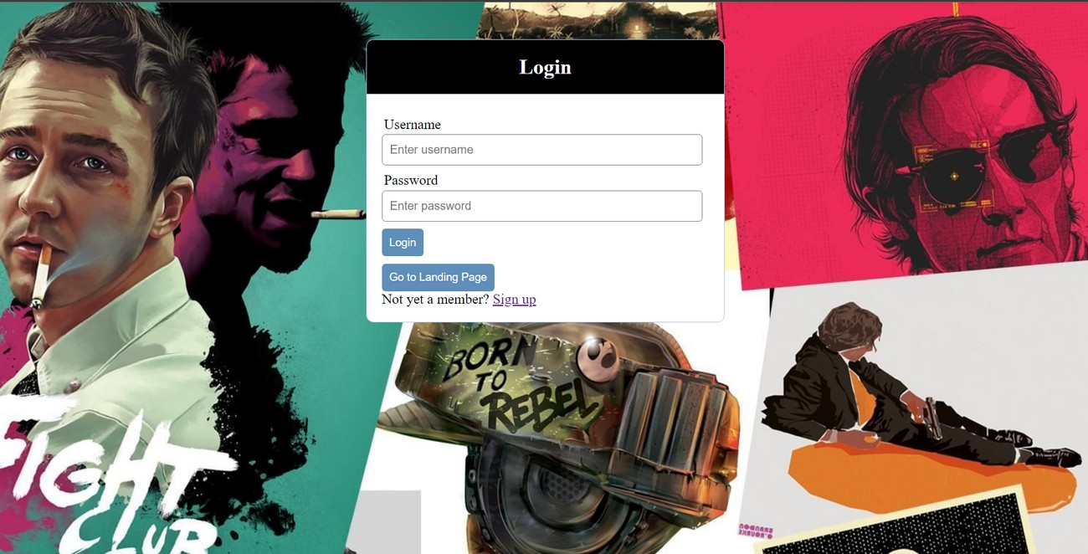
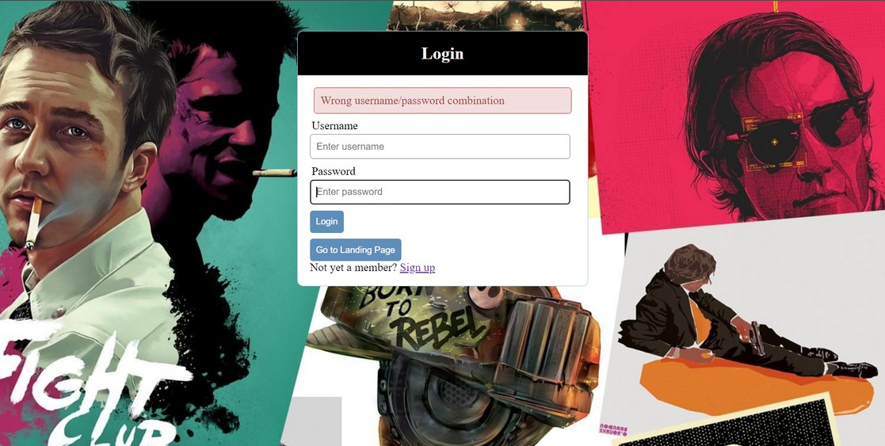
Sign In Page
In this page, the user can sign in to the website using their respective username and password.
On clicking the sign in, the application will authenticate the user with the credentials stored.

Slide 9
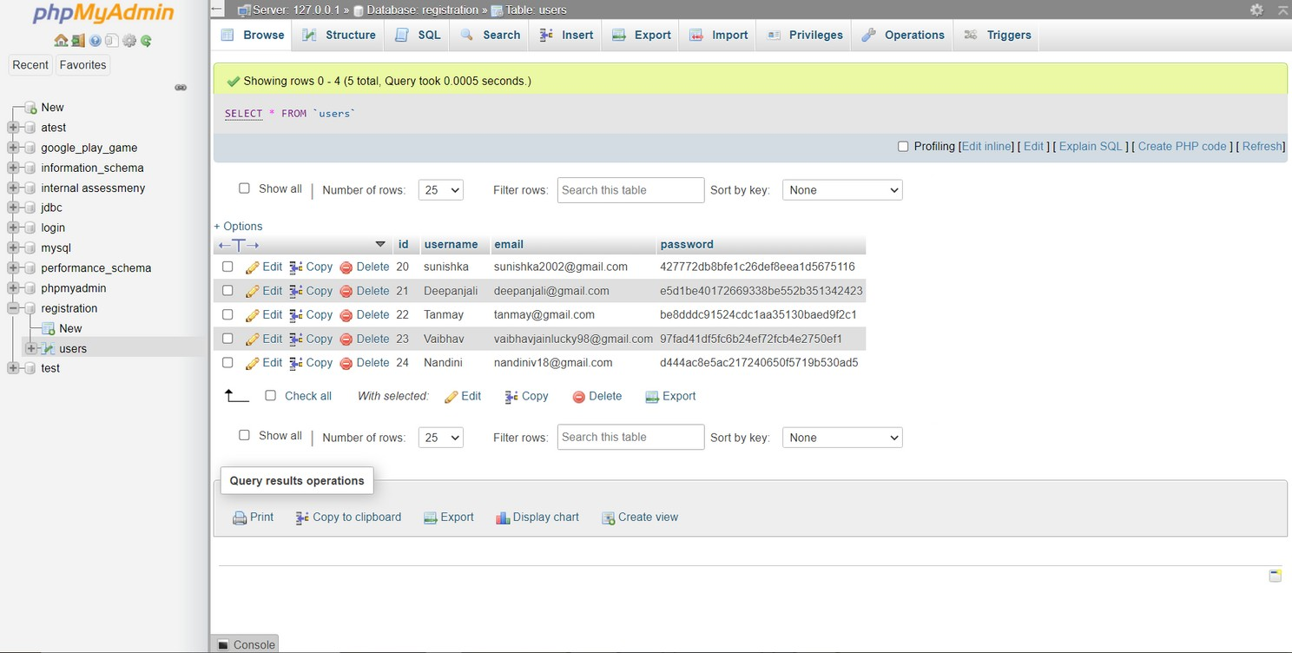
Database
We have used phpMyAdmin and MySQL for database connectivity ussing XAMPP.
It will store the data of the user and will use it for authentication.

Slide 10
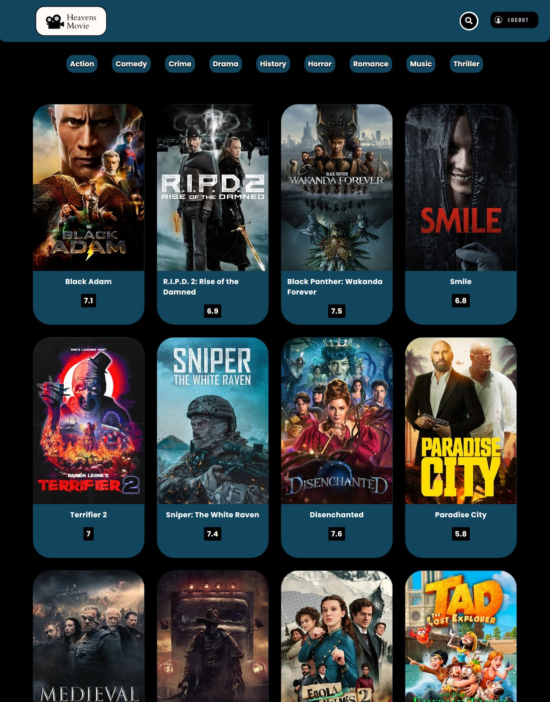

Home Page
Home page is the first thing customers see when they land on your website after authenticating his/her credentials .This is the place to capture their attention.
It consist of the Icons of different trending and latest movies.

Slide 11
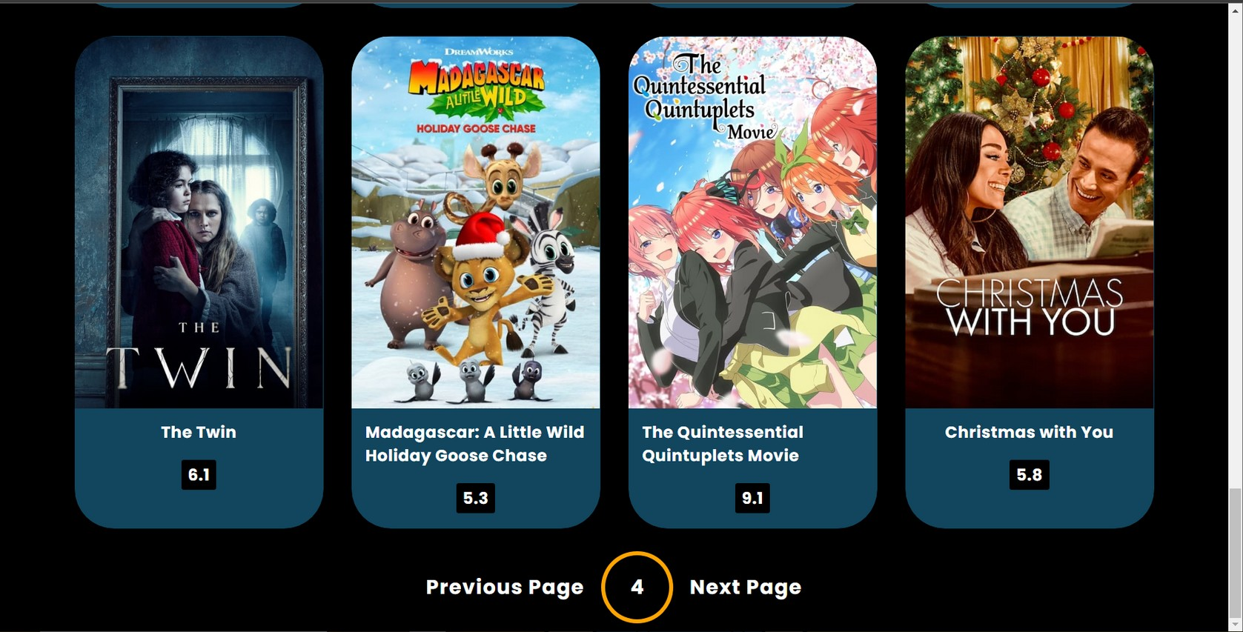
Pagination
It is used to switch between next and the previous page.

Slide 12



Functionalities of Heavens Movies
It tracks all the information of Movie, Shows, User, etc.
Provides the searching facilities based on various factors such as Movie Genre.
We can get the whole information about that particular movie by just hovering the cursor onto it. We can get the idea of movies whether they are worth watching or not by getting the IMDB ratings.
We can watch out the trailer of the movie on Youtube by just clicking on the know morebutton. We can search movies of our choices.

Slide 13
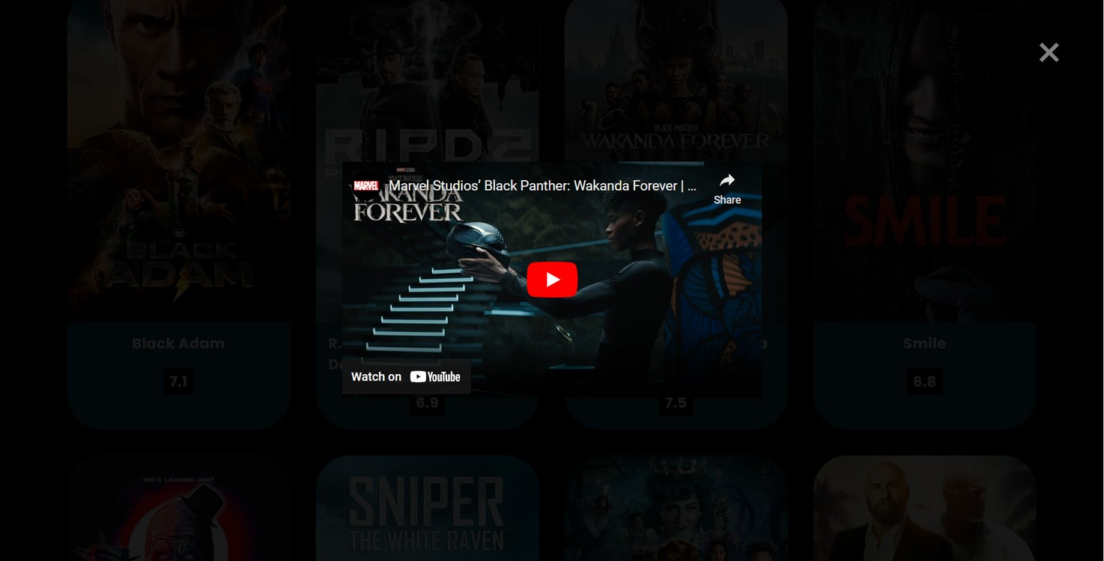
Watch Trailer
Trailers provide moviegoers with a sample of what is to come, giving viewers a basic understanding of the story's plot and genre.

Slide 14
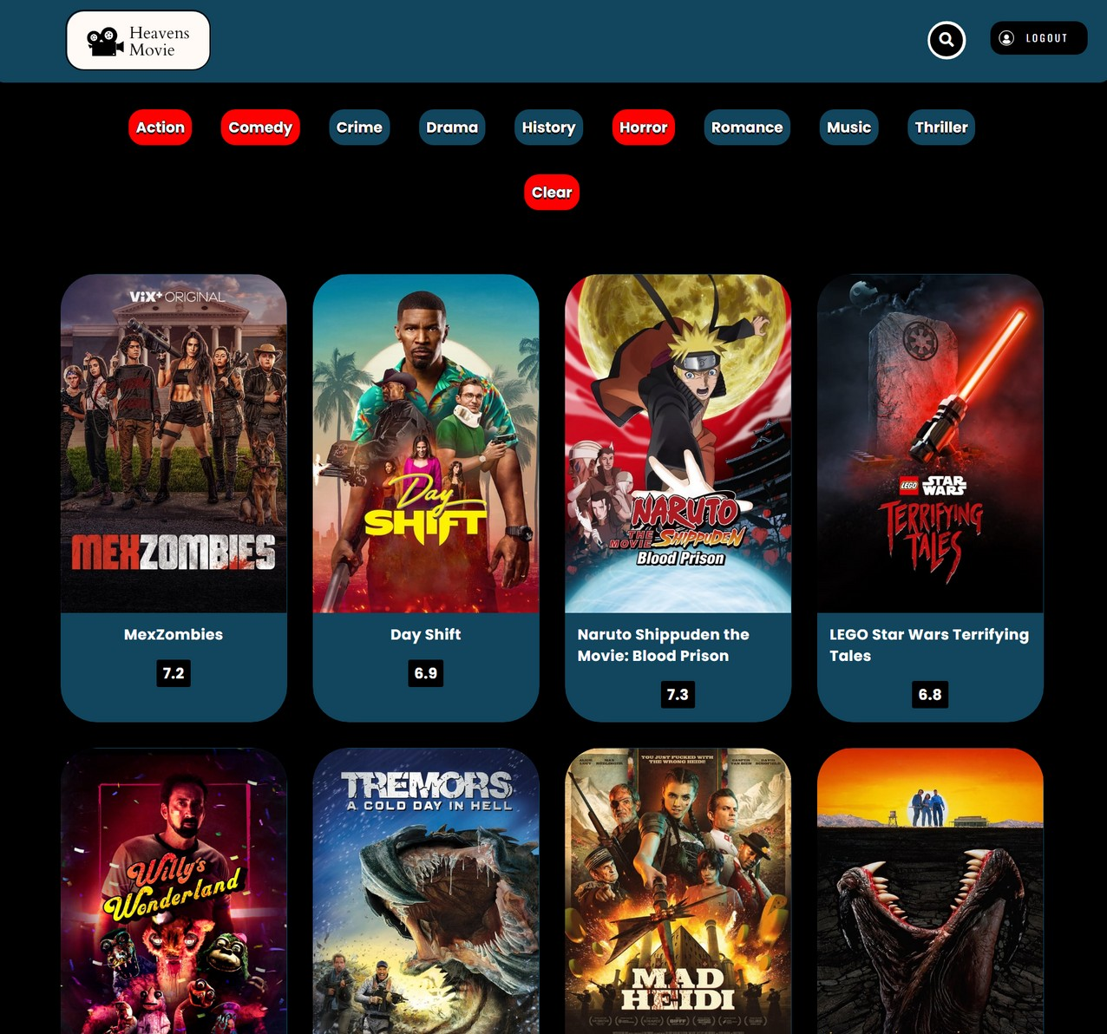
Genres
Search movies of a specific genre by clicking on the buttons and unselect them by using the clear button.

Slide 15

THANK YOU
W W W . R E A L L Y G R E A T S I T E . C O M

